Slide 1
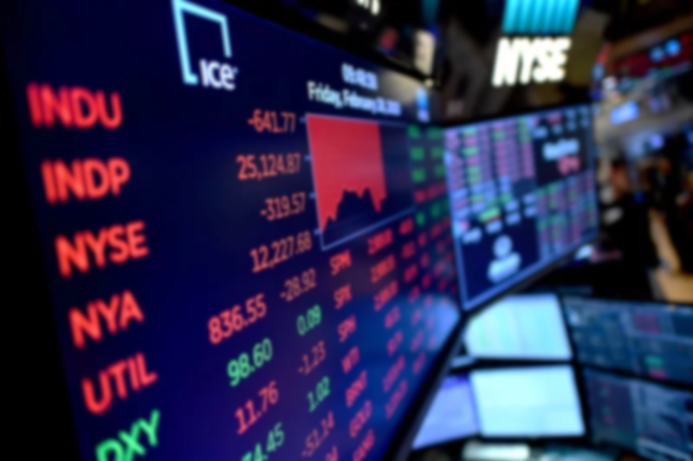

Finance and Risk Analytics – Capstone Project
Finance and Risk Analytics –
Capstone Project

Slide 2
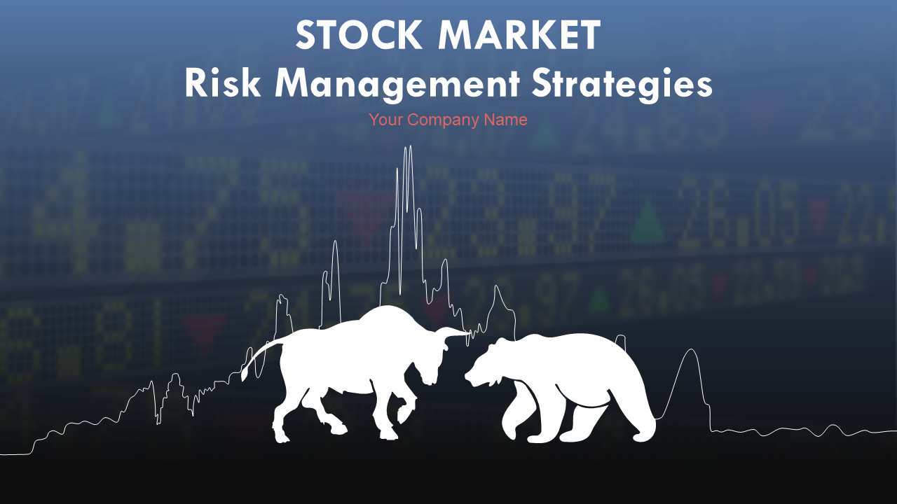
Executive Summary
Presented By:–
Vaishali Jain

Slide 3
Stock Market Analysis & Portfolio Management
Problem Statement :-
A Portfolio Manager makes investment decisions and carries out other related activities on behalf of vested investors. Their main objective is to realize the needs of the investor and suggest a suitable portfolio that meets all the expectations. They are responsible for establishing the best investment strategy, selecting appropriate investments along with the right allocation.
Consider yourself working for an associate at an investment firm that manages accounts for private clients. Your role requires you to analyze a portfolio of stocks to provide consultation on investment management based on client’s requirement. Your task is to provide consultation to two different investors, Mr. Patrick Jyenger and Mr. Peter Jyenger based on their requirements and financial objectives. You can refer to the elements mentioned in the video to develop the investor persona.

Slide 4
Stock Market Analysis & Portfolio Management
Expected Goals :-
Following points summarize the expected tasks in the assignment :
Use the elements of technical analysis to understand the trend of the underlying stocks. The metrics associated with risk and returns must help realize whether the security meets the criteria of the investor’s financial goals.
Use the metrics and the visualizations to compare the performance of the available securities against each other, and also against the market index, S&P500.
The findings should be aligned with the investor persona to select the appropriate stocks for the portfolio.
After the selection of stocks, the portfolio must be validated using the active investment strategy to estimate the prices in future. To check if the portfolio has the potential to fulfil the financial goals set by the investor.

Slide 5
Data Loading & Pre-Processing
Loading and Reading Data
Merging different stock files into one data frame
Cleaning the data
Missing values treatment
Saving the cleaned dataset for future reference
Data Exploration & Visualization
Actual Stock Values
Normalized Stock Values
Daily Returns
Stock Price dispersion from mean
Correlation Analysis
Fourteen Days moving average
Model Building & Evaluation
Forecasting the stocks using Arima Model
Recommendations based on the technical analysis
Creating and selecting the best portfolios for clients
Methodology

Slide 6

1. Data Loading & Pre-Processing
Loading and Reading Data
Merging different stock files into one data frame
Cleaning the data
Missing values treatment
Saving the cleaned dataset for future reference

Slide 7
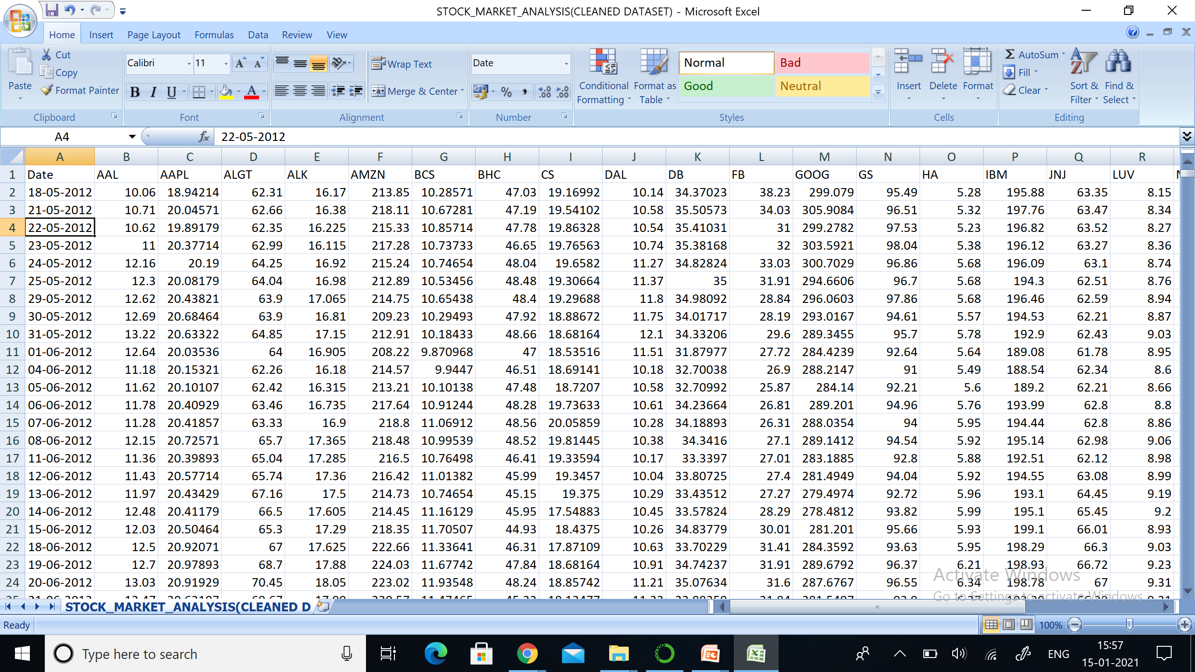
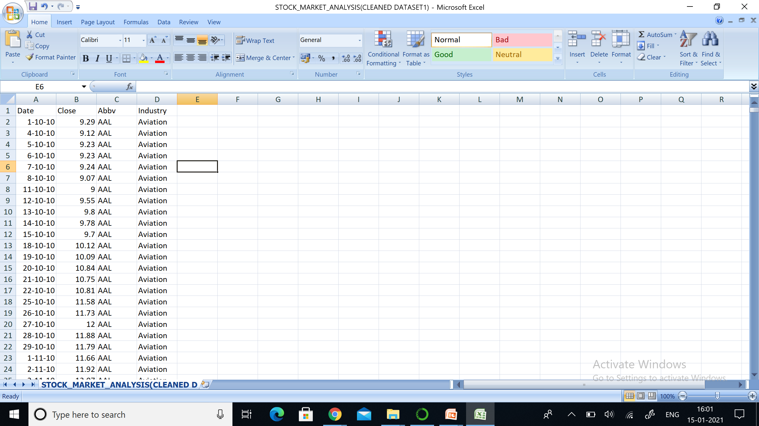
These are the cleaned datasets we get after the data pre-processing step.

Slide 8


2. Data Exploration & Visualization
Actual Stock Values
Normalized Stock Values
Daily Returns
Stock Price dispersion from mean
Correlation Analysis
Fourteen Days moving average

Slide 9
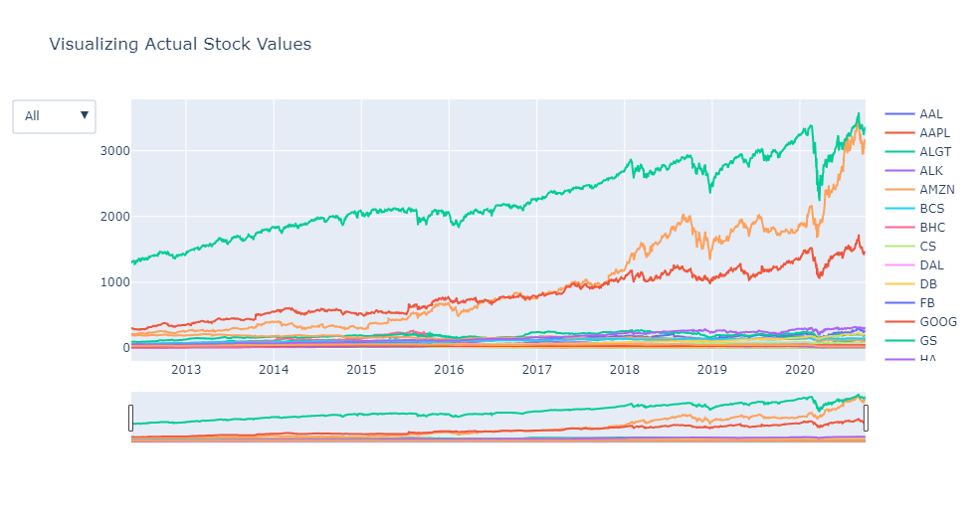
a) Actual Stock Values
1. The Companies across all the 4 Sectors that show UPTREND throughout are :
AMZN ,AAPL ,MSFT, GOOG - Technology Sector
JNJ,MRK - Healthcare Sector.
c) MS - Finance Sector.
2. Other Companies across all the sectors show either DOWNTREND or a MIX of both uptrend and downtrend.

Slide 10
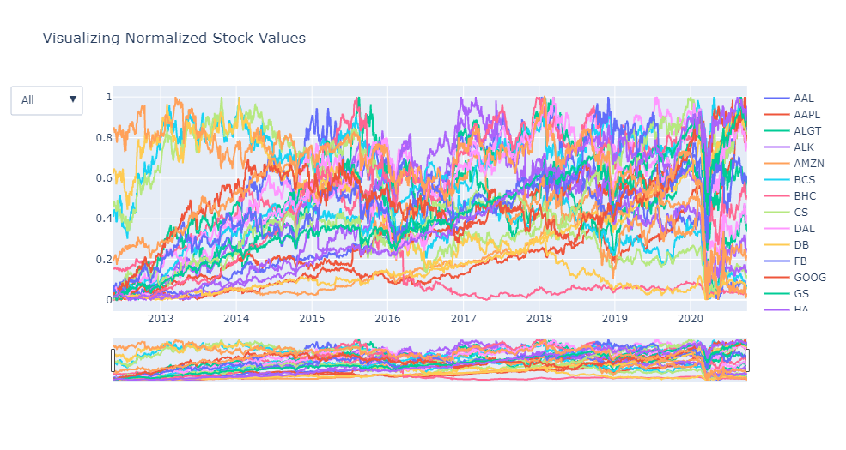
b) Normalized Stock Values
b) The trendlines show a similar pattern for all the companies across all the 4 sectors as they did for the ACTUAL STOCK VALUES.

Slide 11
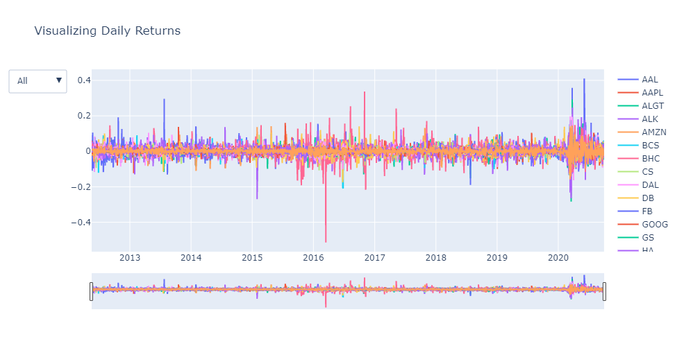
c) Daily Returns
1.INDUSTRY-SPECIFIC ANALYSIS: The Maximum Stock Daily Return per year and increase with each year is shown by the Technology Sector overall followed by Healthcare Sector.
2.COMPANY-SPECIFIC ANALYSIS: The top 5 Companies across all the Industries with Max. Daily Returns are : WFC,UNH,RHHBY,PFE and MSFT.

Slide 12
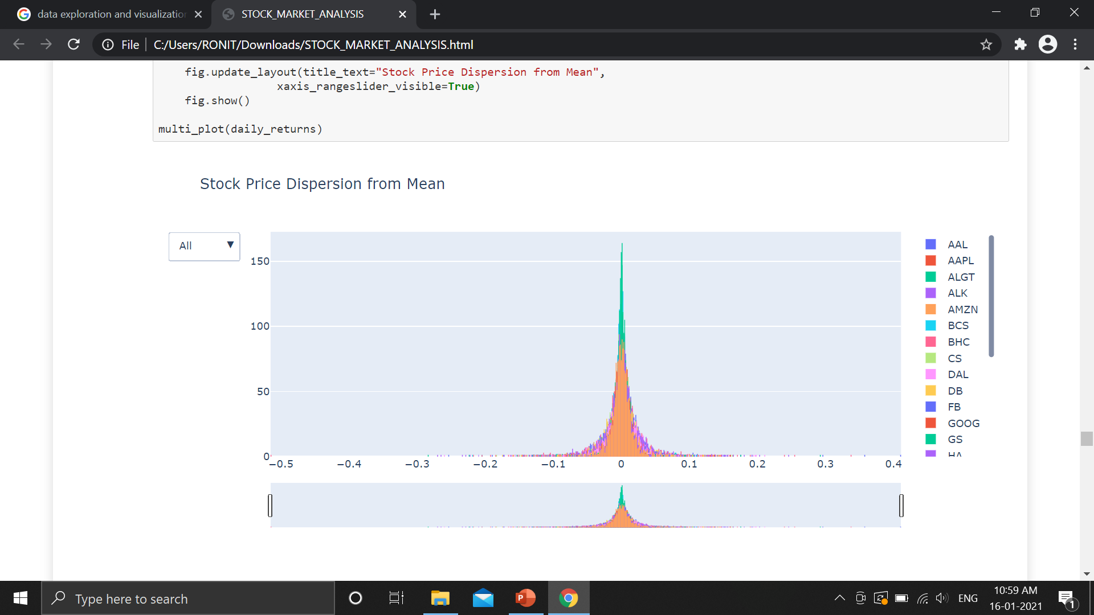
d) Stock Price Dispersion from Mean
d) This histogram could be used to measure the risk and votality of a stock. The more dispersion in the histogram the more volatile a stock is or in other words more risk is involved.

Slide 13
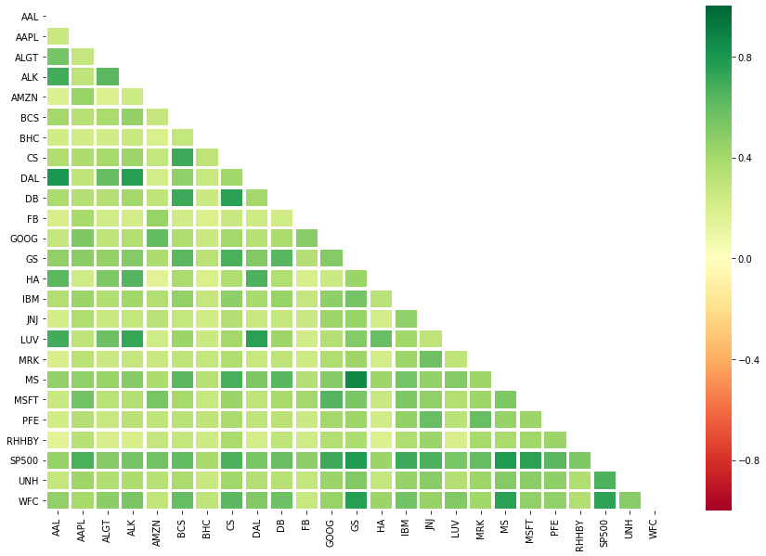
e) Correlation Analysis of Daily Returns among the Stocks
e) Some of the Highly Correlated Company Pairs are :-
1.MS & GS
2.DAL & AAL
3.DAL & ALK
4.DB & CS
5.CS & BCS

Slide 14
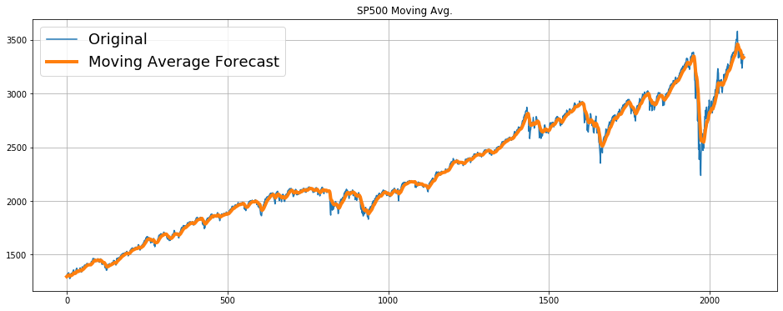
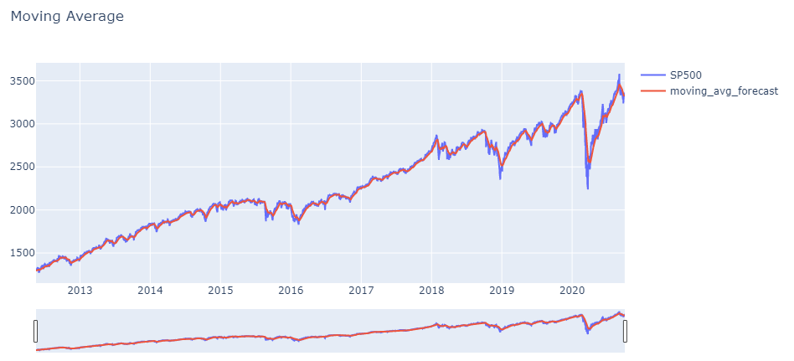
14-days Moving Average of Stock
f)
g)

Slide 15
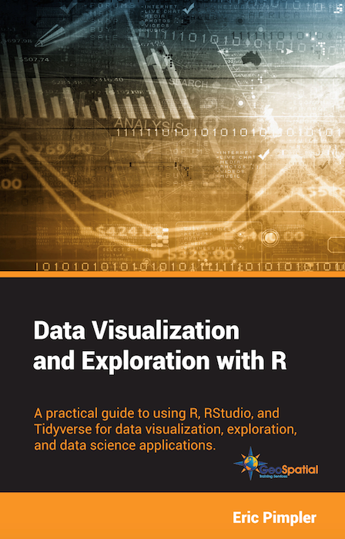
3. Model Building & Evaluation
Forecasting the stocks using Arima Model
Recommendations based on the technical analysis
Creating and selecting the best portfolios for clients

Slide 16
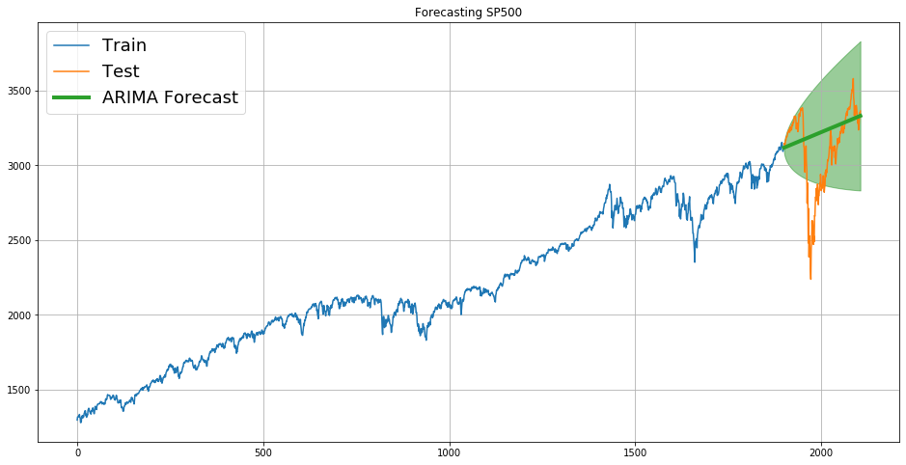
ARIMA Model
The Machine learning model used to predict the outcome of the stocks is ARIMA.
This model gives us a confidence interval to facilitate the stock prices

Slide 17
Profile of the Investors
Conditions and Goals of the Investor :-
Client 1: Mr. PATRICK JEYENGAR
Conservative investor.
Wants to maintain decent standard of living.
Wants to invest 500k $ for minority stake and remaining 500k in equities
Double his capital with less risk over 5 years
Recommendations :-
His portfolio should look at stocks with least deviation from mean and less volatility in daily returns and least risk.

Slide 18
Profile of the Investors
Conditions and Goals of the Investor :-
Client 2: Mr. PETER JEYENGAR
Risk Taker
Consistent with his attitude towards risk.
Wants to invest 1 million $ in high margin stocks
Expecting very high return over 5 years
Recommendations :-
His portfolio should look at stocks with higher returns and moderate-to-high risk or volatility.

Slide 19
Portfolio Selection
Analyze the stocks on various matrices such as, Stock Values, Daily Returns, Stock price dispersion from mean and moving average of stocks.
Visualization on these matrices helped us in choosing stocks for our clients and preparing a suitable portfolio.
We will look at the two portfolios created for both the clients and select the best out of the two for each client considering all the matrices analyzed under the technical analysis of the stocks.

Slide 20

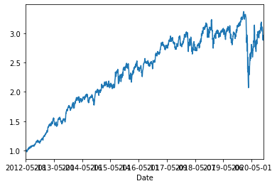
Option (i)
C
L
I
E
N
T
i. We allocate 1/4 of a million for each of the stock.
ii. The average daily portfolio return is around 0.06% based on our initial allocation.
iii. Cumulative portfolio returns is around 198% on the last day, which means almost double in the time.
iv. The Portfolio Risk for the selected stocks come out to be 41%.

Slide 21
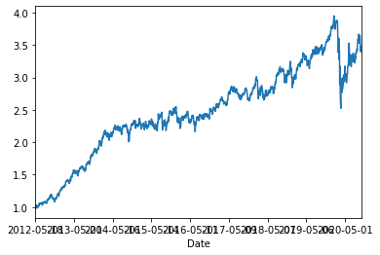
Option (ii)
C
L
I
E
N
T
i. We allocate 1/4 of a million for each of the stock.
ii. The average daily portfolio return is more than 0.06% based on our initial allocation.
iii. Cumulative portfolio returns is around 236% on the last day, which means a little more than double in the time.
iv. The Portfolio Risk for the selected stocks come out to same as 41%.

Slide 22
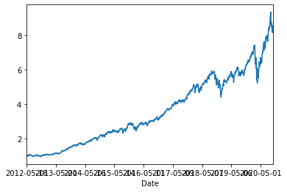
2
Option (i)
C
L
I
E
N
T
i. We select 6 stocks with the most daily returns and allocate 1/6 of million for each stock.
ii. The average daily portfolio return is 1.1% based on our initial allocation.
iii. Cumulative portfolio returns is around 756% on the last day for all these stocks together.
iv. The Portfolio Risk for the selected stocks come out to be 46%.

Slide 23
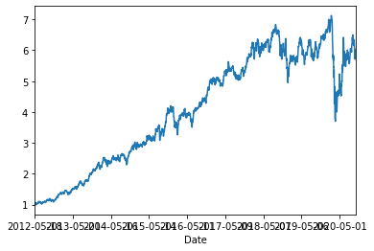
Option (ii)
2
C
L
I
E
N
T
i. We allocate 1/5th of a million for each of the stock.
ii. The average daily portfolio return is .09% based on our initial allocation.
iii. Cumulative portfolio returns is around 484% on the last day for all these stocks together.
iv. The Portfolio Risk for the selected stocks come out to be 57%.

Slide 24
Final Portfolios
Mr. PATRICK JYENGER (Option 2 chosen)
RHHBY – ROCHE HOLDINGS AG BASEL ADR (Healthcare sector)
MRK – MERCK & CO., INC. (Healthcare sector)
AAL – American Airlines group Inc. (Aviation sector)
GOOG – Alphabet (Technology sector)
RETURN = 236%
RISK = 41%
Mr. PETER JYNEGR (Option 1 chosen)
AMZN – AMAZON (Technology sector)
FB – FACEBOOK (Technology sector)
MSFT – MICROSOFT (Technology sector)
AAPL – APPLE INC. (Technology sector)
UNH – UNITED HEALTH GROUP (Healthcare sector)
LUV – SOUTHWEST AIRLINES (Aviation sector)
RETURN = 756%
RISK = 46%

Slide 25
Thank you

